Slide 1
Winter Winning Camp
DATABASE MANAGEMENT SYSTEM
Department Of Career Planning & Development

Slide 2
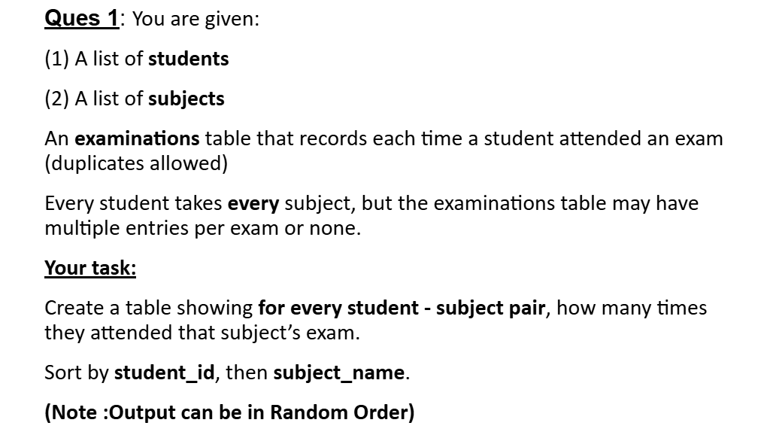
Students and Examinations

Slide 3
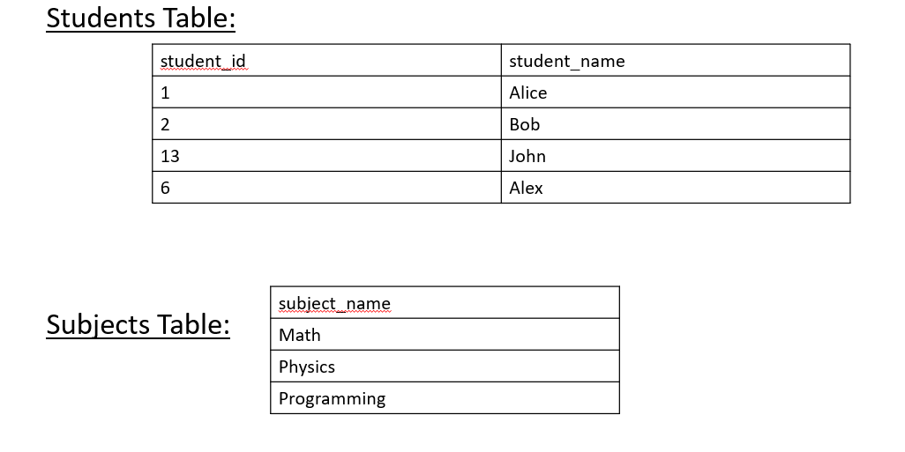

Slide 4
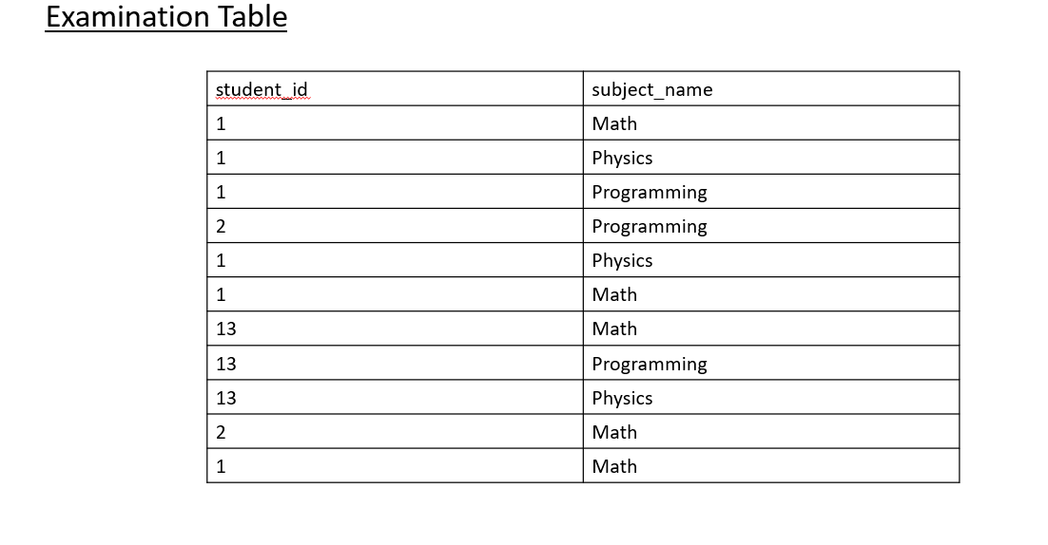

Slide 5
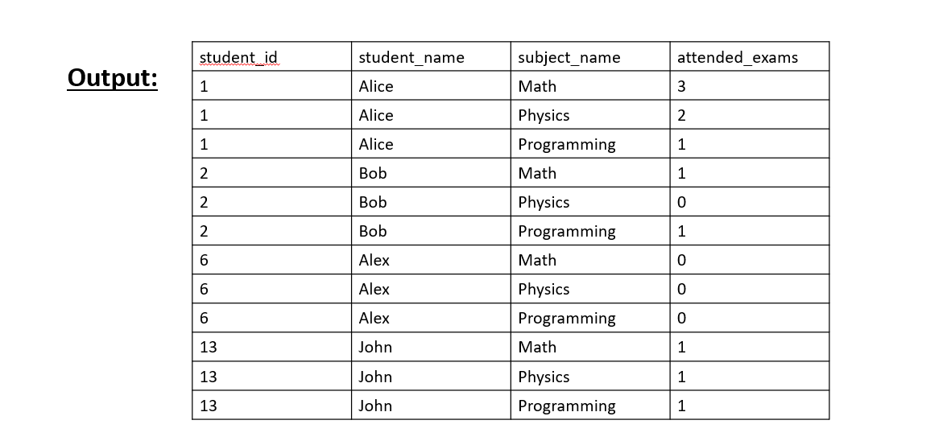

Slide 6

DATE DIFFERENCE:
DATE DIFFERENCE IN DAYS (INTEGER)
Difference in Months (INTEGER)
First Understand DATE_PART() :
In PostgreSQL, DATE_PART() is a function used to extract a specific part of a date, timestamp, or interval.
Syntax:

Slide 7
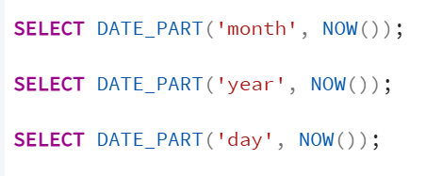
field → The part you want (string)
Example: 'year', 'month', 'day', 'hour', 'minute', 'second’.
Field | Meaning
year | Year number
month | 1–12
day | Day of month(Number)
hour | 0–23
minute | 0–59
second | 0–59
dow | Day of week (0=Sunday)
doy | Day of year (1–365/366)
epoch | Seconds since 1970

Slide 8
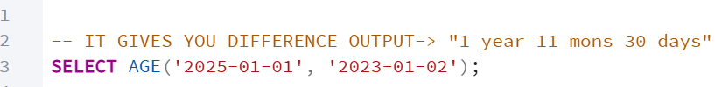


Now understand Date Function
Age() Function :It give date difference with year month days
(1)
(2)
(b) Now difference in Month and below gives you output 4:
From | To
2024-10-21 → 2024-11-21 | 1 month
2024-11-21 → 2024-12-21 | 1 month
2024-12-21 → 2025-01-21 | 1 month
2025-01-21 → 2025-02-21 | 1 month

Slide 9
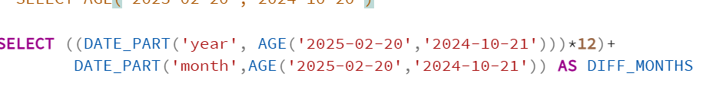
(b) Difference in month
Below gives you output: 3 (It is a month)

Slide 10
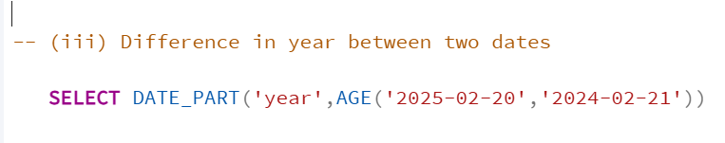
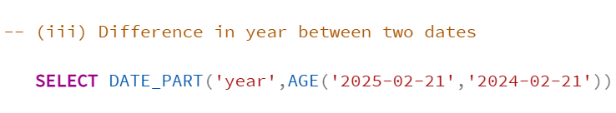
(iii) Difference in Year between two dates
(a)
Output : 0 because 1 year complete from ‘2024-02-21’ to ‘2025-02-21’
(b)
Output: 1

Slide 11
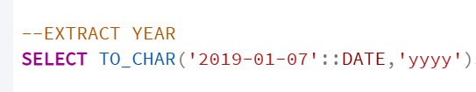

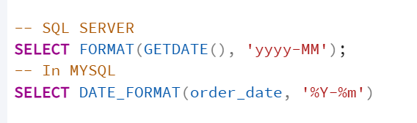
To_char() Function:
Extract Year
Extract Year With Month
In SQL SERVER AND MYSQL: All are small in MYSQL (For year also)

Slide 12
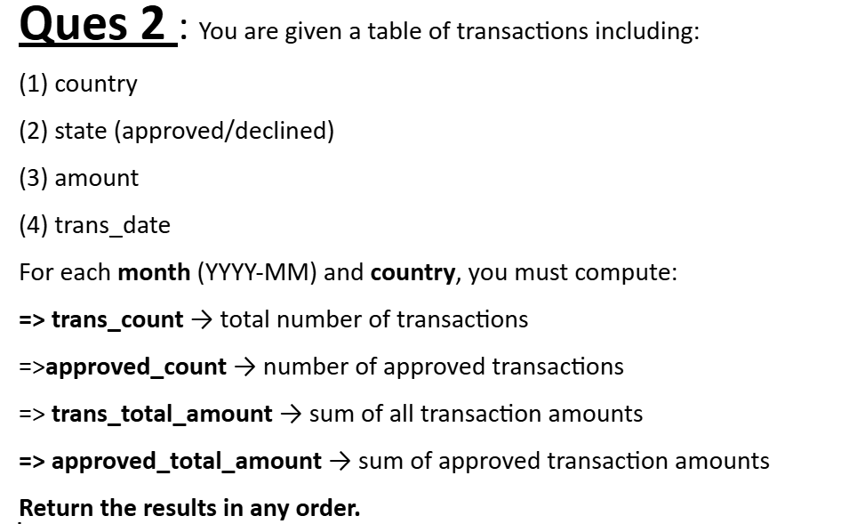
Monthly Transactions

Slide 13
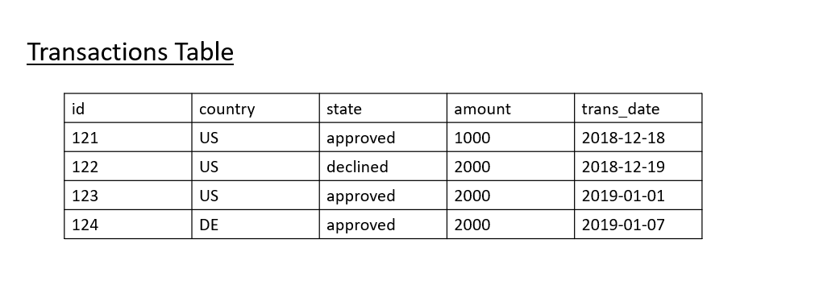

Slide 14
